Slide 1

Weather Forecasting System
Project Guided by :
Prof. Ratan Kumar Saha
Professor
Presented by :
Aryan Raj (CS15MI0396)
Aftab Hussian (CS15MI0447)

Slide 2
Content
Abstract
Literature Review
Description of the Component
Block Diagram
Advantage & Application
Result and Discussion
Conclusion
Future Work
References

Slide 3
Abstract
The proposed system is low-cost solution for monitoring the environmental conditions temperature and humidity at a particular place and makes the information visible anywhere in the world. These values are to be captured using a microcontroller interfaced with a sensor based on Internet of Things (IoT).
In this IoT enabled weather forecasting system project with NodeMCU measures 2 weather parameters using a sensor. These sensors are temperature sensor & humidity sensor. The sensor is directly connected to NodeMCU since it has inbuilt Analog to digital converter. NodeMCU calculates and displays these weather parameters on display unit.

Slide 4
Literature Review #1
Title: IoT Based Weather Monitoring System for Effective Analytics
Author: Ferdin Joe and John Joseph
Publication: International Journal of Engineering and Advanced Technology, April 2019
Objective
This implementation of weather monitoring system is done using Raspberry Pi and the data insights are generated in web based portal. The access to this data is available in the intranet with the current level of implementation and it could be made public when the data is made to store in cloud servers or other sources in the internet. This proposed system is the most compact unit for measuring weather parameters in regions suffering from pollution. This device in multiple nodes can be connected to the internet from various locations of study. This connectivity will aid the user to monitor the weather metrics corresponding to pollution over a centralized data analytics server.

Slide 5
Literature Review # 2
Title: IoT Based Weather Monitoring System
Author : R Suresh Babu, K Anushya
Department of Electronics and Communication Engineering, Kamaraj College of Engineering
and Technology, Madurai, Tamil Nadu, India
Publication: International Journal of Advanced Research Trends in Engineering and Technology (IJARTET), Vol. 5, Special Issue 13, March 2018
Objective
By keeping the embedded devices in the environment for monitoring enables self-protection (i.e., smart environment) to the environment. To implement this need to deploy the sensor devices in the environment for collecting the data and analysis. By deploying sensor devices in the environment, we can bring the environment into real life i.e. it can interact with other objects through the network.

Slide 6
Literature Review # 3
Title: Internet of Things (IOT) based Weather Monitoring System
Author: Girija C, Andreanna Grace Shires, Harshalatha H and Pushpalatha H P, Department of Electronics and Communication, NIEIT, Mysuru
Objective
Department of Electronics and Communication, NIEIT, Mysuru. The system proposed in this paper is an advanced solution for monitoring the weather conditions at a particular place and make the information visible anywhere in the world. The technology behind this is Internet of Things (IoT), which is an advanced and efficient solution for connecting the things to the internet and to connect the entire world of things in a network. Here things might be whatever like electronic gadgets, sensors and automotive electronic equipment. The system deals with monitoring and controlling the environmental conditions like temperature, relative humidity and CO level with sensors and sends the information to the web page and then plot the sensor data as graphical statistics. The data updated from the implemented system can be accessible in the internet from anywhere in the world.

Slide 7
Required Components
To develop this experiment as PoC, we need the following components:
NodeMCU
DHT11
Breadboard
Jumper Cable
Battery

Slide 8
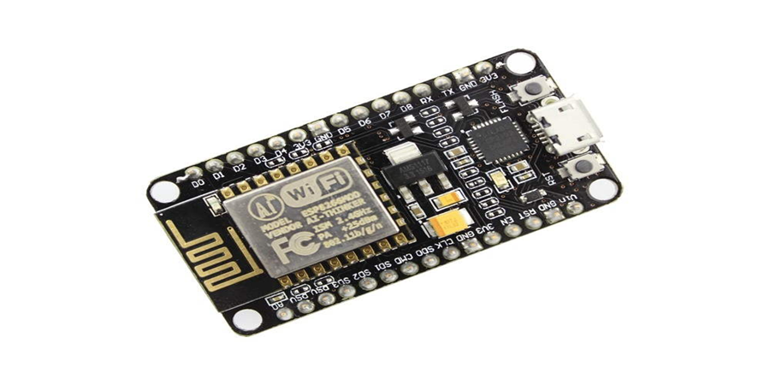
NodeMCU
NodeMCU is an open source LUA based firmware developed for ESP8266 Wi-Fi chip.
The ESP8266 is a low-cost Wi-Fi chip developed by Espressif Systems with TCP/IP protocol. For more information about ESP8266, you can refer ESP8266 WiFi Module.
NodeMCU Dev Kit has NodeMCU like Analog (i.e. A0) and Digital (D0-D8) pins on its board.
It supports serial communication protocols i.e. UART, SPI, I2C etc.

Slide 9
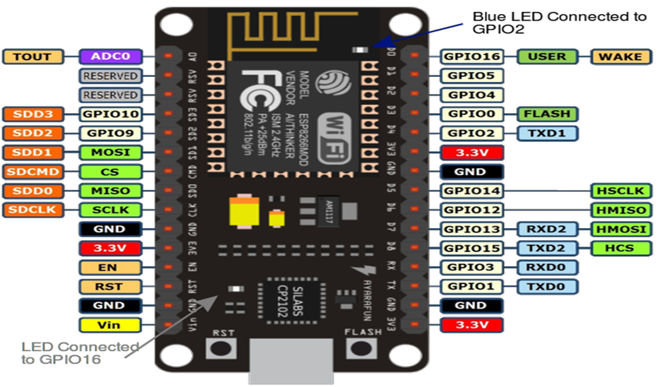
NodeMCU Circuit

Slide 10
Application of NodeMCU for Our Project
We are using NodeMCU and sensor DHT11 to capture the data of humidity and temperature from the atmosphere.
Storing data of humidity and temperature of a remote location in a database, where these data will be uploaded in the cloud.

Slide 11
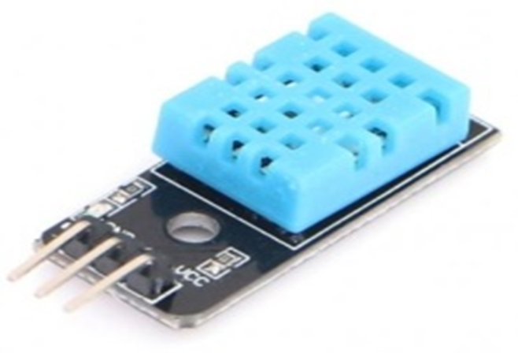
Sensor DHT11
The DHT 11 is a commonly used Temperature and humidity sensor.
The sensor comes with a dedicated Negative Temperature Coefficient (NTC) to measure temperature and an 8-bit microcontroller to output the values of temperature and humidity as serial data.
The sensor is also factory calibrated and hence easy to interface with other microcontrollers.

Slide 12
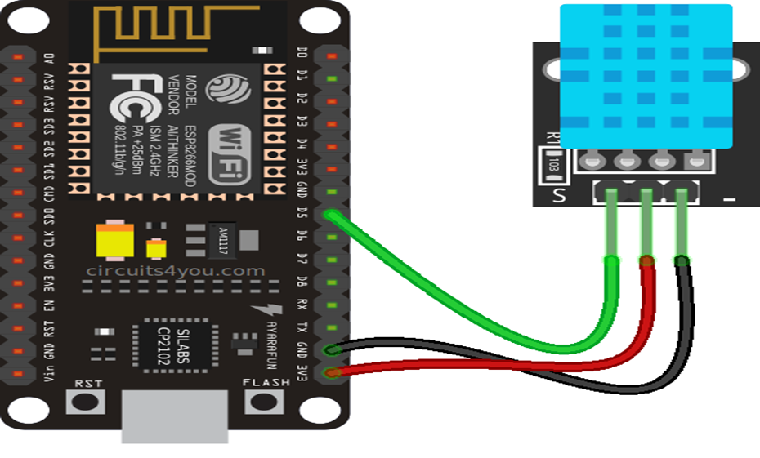
Connection Between NodeMCUand DHT11

Slide 13
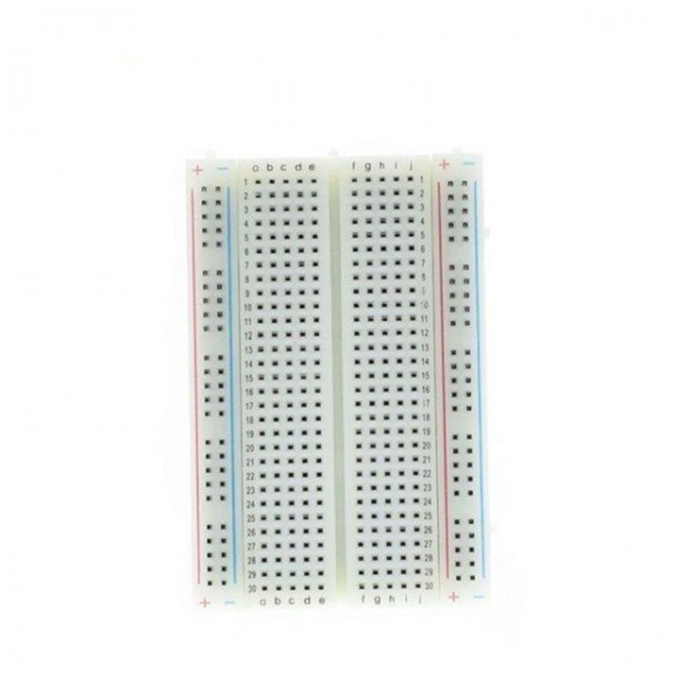
Breadboard
A breadboard is a widely used tool to design and test circuit.
You do not need to solder wires and components to make a circuit while using a bread board.
It is easier to mount components & reuse them.

Slide 14
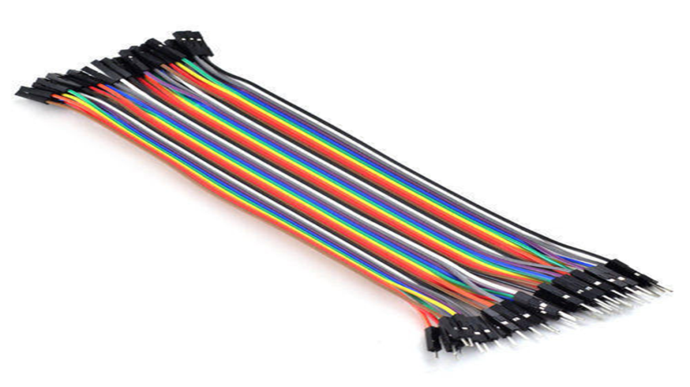
Jumper Cable
Jumpers are like on /off switches they may be removed or added to alternate component performance options.
A jumper is made of materials that conduct electricity
It is sheathed in a nonconductive plastic covering to prevent accidental short circuit

Slide 15
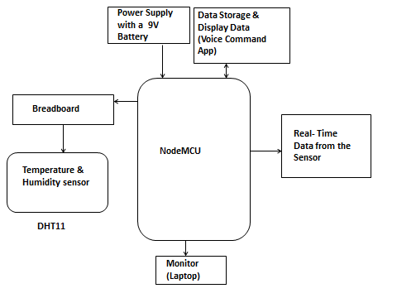
System Block Diagram (logical)

Slide 16
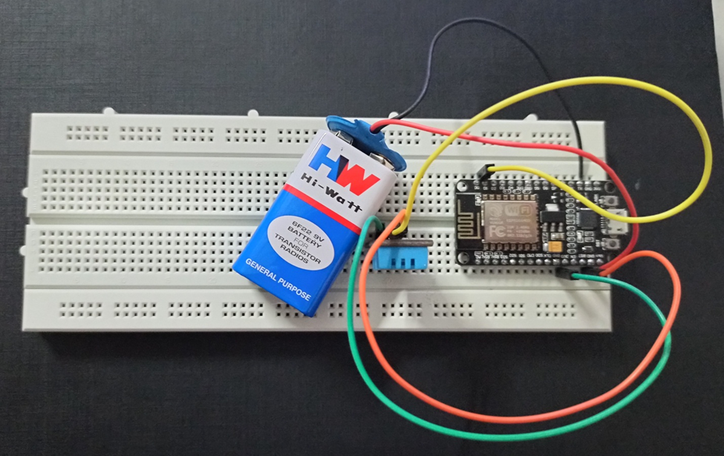
System Block Diagram (Physical)

Slide 17
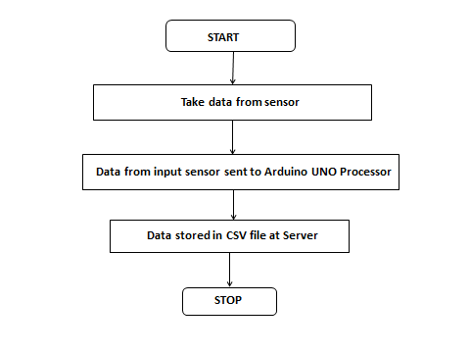
System Data Flow

Slide 18
Advantage & Application
Current Temperature and Humidity Predictability
Portable
Pocket Friendly
User friendly
Precise and Accurate Information

Slide 19
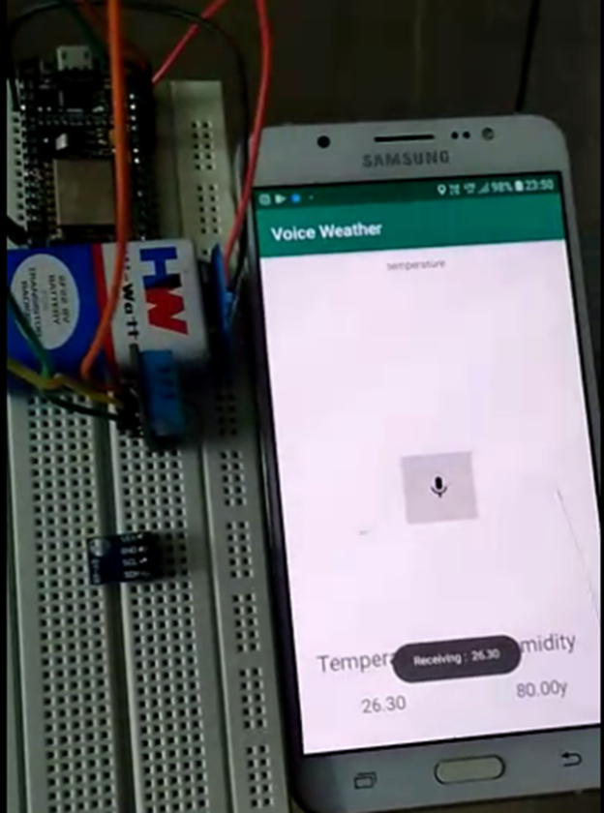
Result and Discussion
The function to access voice recognition was worked upon and is presently being carried out using a self-made app.(Voice Command )
Testing of data collection process has been completed
Output of Temperature and Humidity in voice recognition app.

Slide 20
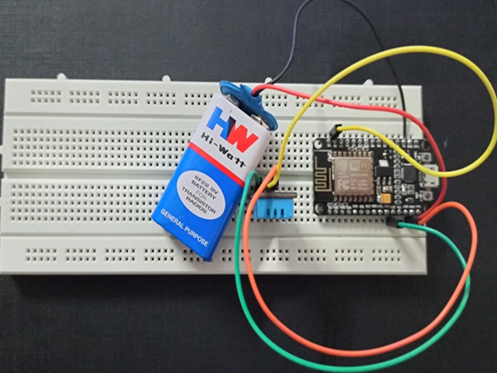
It is Remotely Accessible.
It operate through voice recognition
Precise and Accurate Information
Portable
Pocket Friendly

Slide 21
Conclusion
Work Completed
Requirement analysis with the help of literature survey
Studied the components to build the low cost system
Studied about the application of system
It is remotely accessible
It operate through voice recognition
Work in Progress
Currently we are working on the Air Pressure sensor.

Slide 22
Future Work
This model has been design for different features to be added different sensor without changing any existing hardware modules. The addition of air pressure sensor, light sensor and rain level sensor which will be carried out as the scope of future work.
This model has been designed in such a way that it can cater to the need of the general public as well as the business class.
Air pressure sensor light sensor and rain level sensor can be helpful in weather forecast and can be studied further to get climate details
This design also support being eco-friendly and non-polluting, it can be the most popular sensors to be used in the day to day life of the people.

Slide 23
References
[1] https://www.instructables.com/id/DIY-Weather-Station-Using-DHT11-BMP180-Nodemcu-Ove/ November 24, 2019 at 12:50 PM
[2] https://www.youtube.com/watch?v=OogldLc9uYc October 7, 2019 at 2:50 PM
[3] https://www.youtube.com/watch?v=ObjikQDh1Zc October 18, 2019 at 3:35 PM
[4] https://www.youtube.com/watch?v=xqdC__jZILk November 4, 2019 at 4:20 PM

Slide 24


